Slide 1
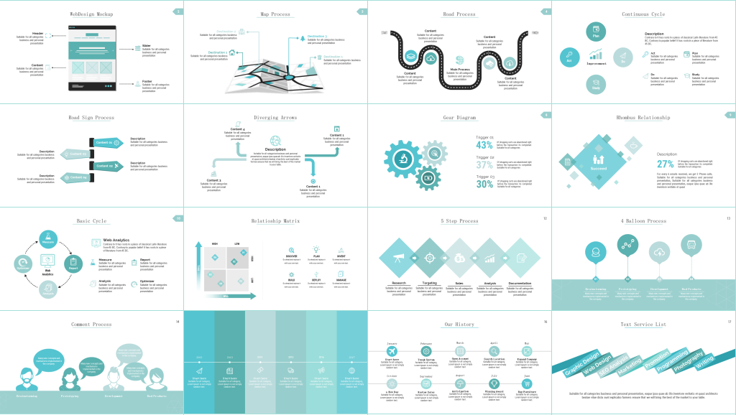

the simulation of
pedestrian evacuation

Slide 2
START
Content
Simulation results of this model
Main Process
The problems we encountered and the improvements to this model
Introduction
FINISH
A brief introduction to the model

Slide 3
We used social force model and A*algorithm. Firstly, the mass and initial position of each pedestrian are randomly generated. According to the real mass of adults, the mass of the pedestrian ranges from 45 kilograms to 80 kilograms. Secondly, According to the direction obtained by A* algorithm, the acceleration of the time is calculated by combining the obstacles within three meters and the forces exerted by pedestrians. The speed and position coordinates of the next time are obtained.Finally, The coordinates are updated successively until the person leaves the room.
Introduction
Assumption
Background
Results
background
Establishment
We simplify several important data.
For example,we would regard each pedestrian as a circle whose radius is 0.2 meters.We use python to randomly generate the initial position and quality. To make the calculation easier, we could assume that the quality of the pedestrians is ranging from 45 kilograms to 80 kilograms, randomly generated. We regard the room as a rectangular wireframe and there are several doors at the edge of the room. Whose thickness is 0.4 meters.
However,we meet some problems.
Pedestrian simulation is an important approach for engineers to evaluate the safety issues of metro buildings. Although there exist many works of pedestrian evacuation, it is still lacking of rich evacuation data to calibrate simulation models.
assumption
results
establishment

Slide 4
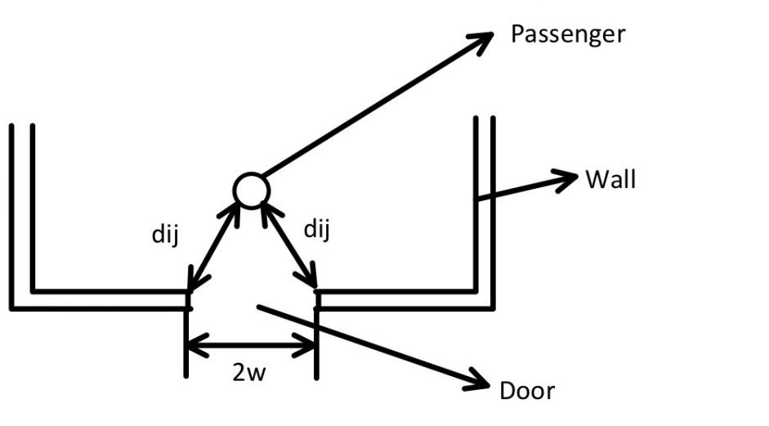
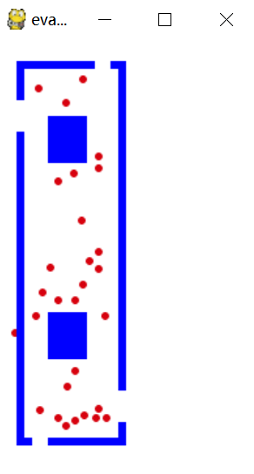
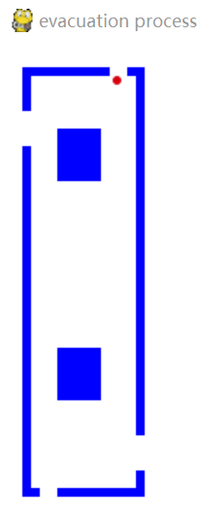
Problems
Problems
Solution:We found out that there are two perspectives’ reasons which caused the problem that the pedestrians’ crash on the obstacles. One of them is the ignorance of the force generated by the obstacles and the other is that the renewal time is too long.
So to solve the problems we recalculate the force generated by the obstacles which is 3 millimeters from the pedestrians. In addition, we adjust the renewal time to 0.008meters/v (the expecting speed), and then go on the next tests.
Description
Obstacles crashing.
During previous tests, we found that the pedestrians were easy to crash on the obstacles, they could not successfully evacuate.
Description
Content 01
Content 01
Pedestrian stagnation (2)
When the pedestrians move to the front of the doors ( in this condition, the acceleration speed of pedestrians is not equal to zero), instead of keep moving out of the room, they would keep trembling right at the door, besides, there are conditions that several pedestrians arrive at the door at the same time so that they crowd against others and nobody could evacuate from the room.
Content 03
Content 03
Solution:We recalculate the acceleration speed and the speed and the location. Because people will not be afraid of oblique collision when it is stagnant, and the update time is very small, this disturbance will only make it move away from the equilibrium position and not hit again.
Description
Content 02
Content 02
Pedestrian stagnation (1)
When the pedestrians move to the front of the doors, or sometimes when their final speed are not fast enough (in this condition, the acceleration speed of pedestrians is zero), instead of keep moving out of the room, they would stay still right at the door.
Content 04
Content 04

Slide 5
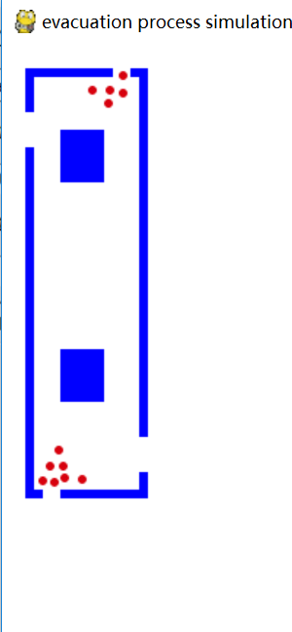
Solution 1:
The polite model: In general, there will be some people who will concede a lot of people. Once the deadlock is broken, they can go out.
If the direction of some pedestrians’ speed changes by more than 90 degrees, this situation is not normal.It can be interpreted as being knocked apart, so in this direction, we try to get him to take a step back, which needs to be realistic. And we carried out the following adjustment.
1.The normal half distance is 0.2 meters.
2.We can not let pedestrians collide with surrounding obstacles, so we take 0.9 times of the shortest distance from obstacles.
3.If the original calculated moving distance is larger than the retreat distance and the
retreat distance is meaningless, the original distance is still taken.
After the improvement of the model, although part of the clogging problem has been solved, there are still some cases. As the original is very close, there is no compromise, still blocking the door, the model failed.

Slide 6
Solution 2:We know that is the culprit that gets in the way of getting out the door. However, people don't go out because they are afraid of hitting the door frame. Can be set to zero?
Try: The man bounced off the door frame.

Slide 7
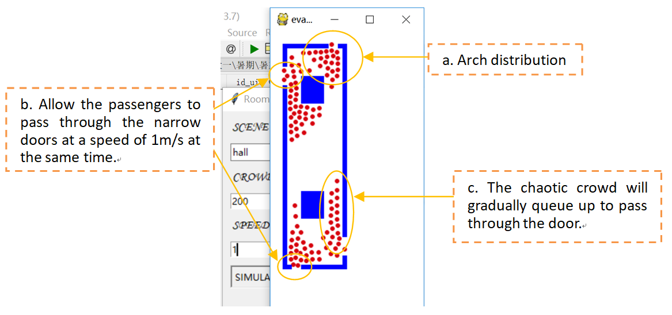
Solution 3:People will avoid hitting the door and will not avoid approaching the door frame.
Take the force of perpendicular to , do not let the presence of the door frame prevent people from going out. But it also preserves the influence of people who don't want to hit the door frame.
As a result, we have got a more successful model:
A.It is obvious that the crowd forms an arch distribution.
B.The door allow the pedestrians to pass through at a speed of 1 meters per second at the same time.
C.The chaotic crowd will gradually queue up to pass through the door.
So far the Pedestrian stagnation problem have got a proper solution.
Try: Basically simulate the reality.
1.The team has basically formed a team in front of the door.
2.Allow the door of 0.8 meters wide to go out together.
3.Everyone will eventually go out, almost no such anomalies.
4.Allow people at 0.2 meters per second to go out normally and include very low speed conditions.
Succeed
The effect after our third try

Slide 8
Problems
Problems
Content 01
Content 03
Content 02
Evacuation speed
People who are queued to go out when there are few people are separated from each other, which affects the speed of evacuation and is not realistic.
Content 04

Slide 9
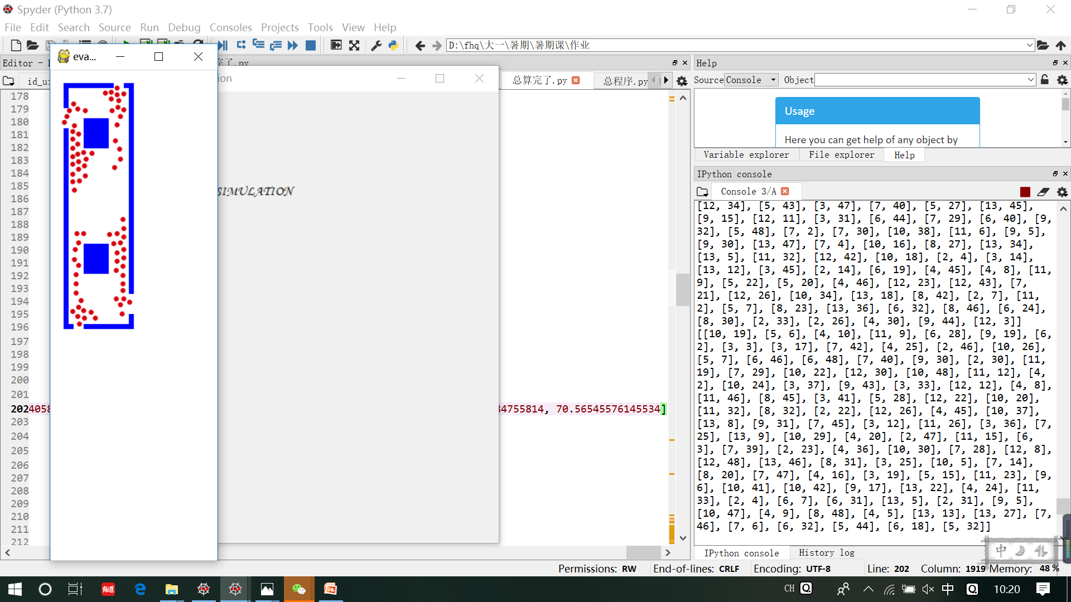
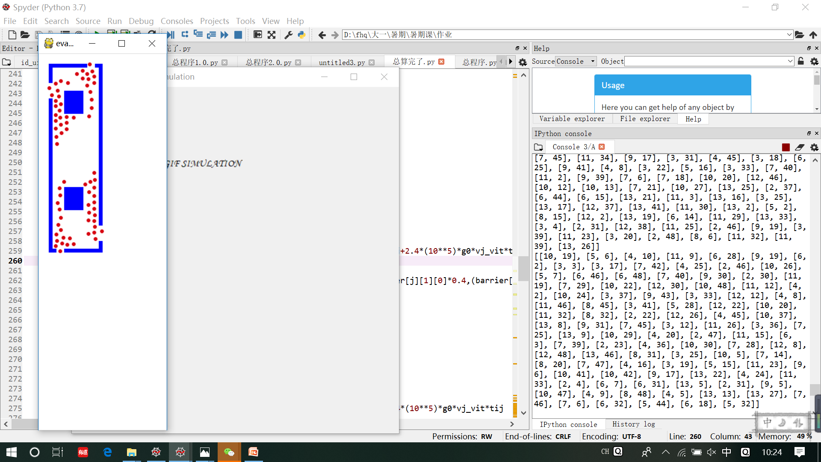
Solution:Try to multiply the coefficient, taking the expected speed of 1 meter per second as an example. After many experiments, we found that when we take a new“ ” equal to 0.4 multiply the original“ ”, the effect is better, and it will not cause too much distance between people, and will not cause people to collide with each other,either.
Measure
Optimizer
Report
Web
Analytics
Analysis
(a)The effect when we take v as 1 meters per second, k as 0 and the evacuation is 22.87 seconds.
(b)The effect when we take v as 1 meters per second, k as 1 and the evacuation is 24.89 seconds.

Slide 10
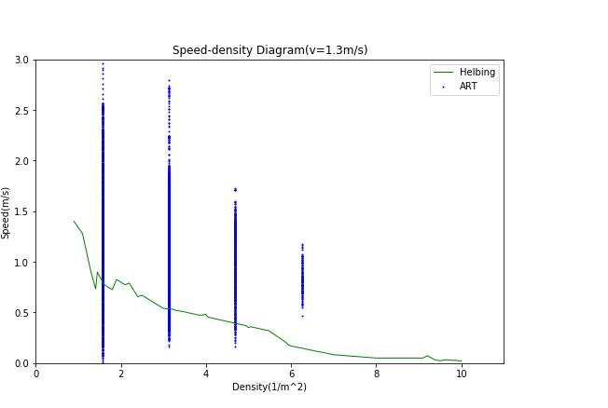
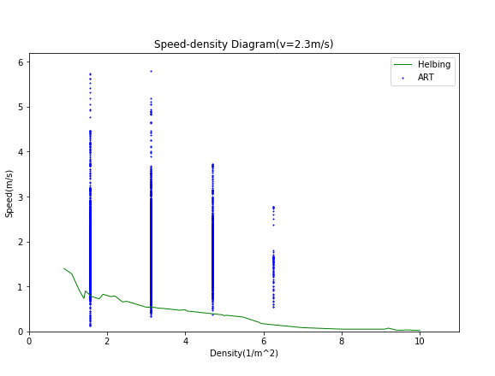
5.Ultimately, It is obvious that the crowd forms an arch distribution. The door allow the pedestrians to pass through at a speed of 1 meters per second at the same time. And the chaotic crowd will gradually queue up to pass through the door.
Conclusions
3.The initial system can not perfectly run, the pedestrians stay still at the door or tremble at the door, crowd at the door as well, we need to recalculate the acceleration speed and the speed and the location.Then,take the force of perpendicular to , do not let the presence of the door frame prevent people from going out. But it also preserves the influence of people who don't want to hit the door frame.
1.The Social force model and the A*algorithm could simulate the pedestrian evacuation problem very well.
The lower speed condition
2.During the running process, sometimes the pedestrians will bump into the obstacles because of the renewal time are not accurate enough, when we adjust it to 0.008 meters/ v(expecting speed), the problem will be solved.
4.People who are queued to go out when there are few people are separated from each other, which affects the speed of evacuation and is not realistic. When we take a new“ ” equal to 0.4 multiply the original“ ”, the effect is better.
The faster speed condition

Slide 11
Thanks

